Slide 1
Angular 2
By : Akash Kale

Slide 2
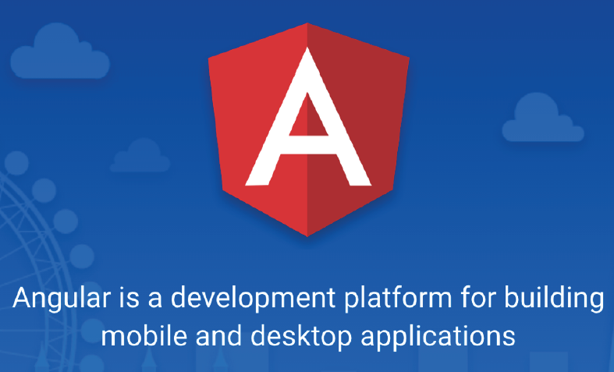

Slide 3
Angular 2/4
Angular allows you to develop single page applications which reload only the part of the page when user interacts with the page by clicking on a link or a button.
Angular uses components to display the content on the page and these components are replaced by other components at runtime when user wants to see other contents while interacting with the page.

Slide 4
Continue...
Angular is a framework for building client applications using HTML and Typescript (a super set of JavaScript) which is compiled to JavaScript.
Angular JS 1.x was limited to a framework to build only web applications, whereas Angular 2 or later has grown into a strong platform which allows you to develop fast and scalable applications across all platforms such as web, mobile web, native mobile and native desktop.

Slide 5
SPA Vs MPA
SPA means Single Page Application
MPA means Multiple Page Application
Faster navigation
Improved user experience
Decoupling of front-end and back-end development

Slide 6
Angular 2/4 setup
Setting up and configuring angular project takes time as it involves adding lot of
JS libraries
Compiler to Typescript
Configuring server etc
So Angular team has provided a high quality development toolset to ease the application set up and configuration one such toolset you can use is Angular CLI (Command Line Interface) which automate your development workflow.

Slide 7
Angular CLI
Create new angular application.
Run a development server with a LiveReload support to preview your application during development.
Add features to your existing angular application
build deployment and production ready application
Run your application’s unit tests
Run your application’s end to end tests(E2E tests)

Slide 8
Pre-requisites for Angular2/4
HTML/HTML5
CSS/CSS3
JavaScript
TypeScript
Web Technologies (Servlet/JSP, PHP, ASP.net – Optional)

Slide 9
Software’s required
Node.js 6.9.0 or later
NPM 3.0 or later (comes with Node.js).
Editor Visual Studio Code or Brackets or Sublime.

Slide 10
Why node.js ?
“Node's goal is to provide an easy way to build scalable Network programs”

Slide 11
What is NodeJS ?
NodeJS is an open source , cross platform runtime environment for server side and networking application.
It is written in JavaScript and can run on Linux , Mac ,Windows , FreeBSD.
It provided an event driven architecture and a non blocking I/O that optimize and scalability. These technology uses for real time application.
It used Google JavaScript V8 Engine to Execute Code.
It is used by Groupon, SAP , LinkedIn ,Microsoft,Yahoo ,Walmart ,Paypal.

Slide 12
What is unique about Node.js?
JavaScript used in client-side but node.js puts the JavaScript on server-side thus making communication between client and server will happen in same language
Servers are normally thread based but Node.JS is “Event” based. Node.JS serves each request in a Event loop that can able to handle simultaneous requests.
Node.JS programs are executed by V8 JavaScript engine the same used by Google chrome browser.
Notes:
Thread based servers like Apache server will serve each web request as individual threads which doesn’t fit well for concurrent connections.

Slide 13
Node.js is not……
● Another Web framework
● For beginner
● Multi-thread
In Simple Node.js
Node.js = Runtime Environment + JavaScript library.

Slide 14
Why node.js ?
● Non Blocking I/O
● V8 JavaScript Engine
● Single Thread with Event Loop
● 40,025 modules
● Windows, Linux, Mac
● 1 Language for Frontend and Backend
● Active community

Slide 15
Why JavaScript ?!!!
Friendly Callbacks
Ubiquitous
No I/o Primitives
One language to RULE them all
JavaScript is well known for client-side scripts running inside the browser
node.js is JavaScript running on the server-side
SSJS -> Server-Side JavaScript
Use a language you know
Use the same language for client side and server side

Slide 16
ES6
JavaScript is ES6 or ES 2015 as well as ES7 or ES2016, ES means ECMAScript which is a standard for scripting language ECMA means European Computer Manufacturer's Association.
The ES6 or ES6 script can’t understand by browser.
So it required transpiler, which help to convert ES6 or ES7 to ES5(JavaScript).
TypeScript transpiler
Babel transpiler
Traceur transpiler

Slide 17
TypeScript
TypeScript is a free and open source programming language developed and maintained by Microsoft.
It is a strict superset of JavaScript, and adds optional static typing and class-based object-oriented programming to the language.
It is designed for development of large applications and transpiler to JavaScript. As TypeScript is a superset of JavaScript, any existing JavaScript programs are also valid TypeScript programs.

Slide 18
Features of the TypeScript
Data Types Supported
ES6 function
Classes
Inheritance
Interface
Modules
Source File Dependencies

Slide 19
Variable declaration
In ES6, we can use var, let and const keyword to declare the variable.
var keyword is used to declare the function scoped variable.
let keyword is used to declare the block scoped variable.
const keyword is used to declare the constant value.

Slide 20
Data Types
Any
Primitive
number
boolean
string
void
null
undefined - Same as JS
Array
Enum

Slide 21
TypeScript functions
Normal function
Function with parameter
Function with parameter variable with datatype
Function with return types.
Function with required parameter
Function with default parameters
Function with optional parameters

Slide 22
Continue...
Rest parameter
Spread parameter
Arrow function (lambda expression)
Function return more than one value

Slide 23
ES6 String
let msg1=“Simple Msg”; //double quote
let msg2=‘Simple Msg’; // single quote
let msg3=`Simple Msg`;//backticks quote
let name =“Raj Deep”;
let msg4 = `The name is
${name} `; //string template

Slide 24
Different way for loop
let abc=[“a”,”b”,”c”,”d”]
First way
for(let i=0;i<abc.length;i++){
console.log(abc[i])
}
Second way
for(let index in abc) {
console.log(abc[index])
}

Slide 25
Continue...
Third way
for(let val of abc) {
console.log(val)
}
Fourth way
abc.forEach(function(value){
console.lot(value)
})

Slide 26
using arrow function
Fifth way
abc.forEach((value)=>console.log(value))

Slide 27
Classes
Contains set of properties and behaviour
Instance methods/members
Static methods/members
Can implement interfaces
Inheritance
Single constructor
Default/Optional parameter
ES6 class syntax

Slide 28
Inheritances
Using classes
Using interface

Slide 29
Source File Dependencies
Can be done using reference keyword
Must be the first statement of file
Paths are relative to the current file
Can also be done using tsconfig file

Slide 30
Example Demo
///<reference path=“./a.ts”>
///<reference path=“./b.ts”>
abc();
xyz();

Slide 31
Modules
Modules can be defined using module keyword
A module can contains sub-modules, class, enum or interfaces. But can’t directly contains functions.
Modules can be nested(sub-modules).
Classes and Interfaces can be exposed using export keyword.

Slide 32
Types of module
Internal module
External module

Slide 33
Sample Example internal module
a.ts
module A{
export function abc(){
console.log("Abc function from a.ts")
}
}
b.ts
module B {
export function abc() {
console.log("Abc function from b.ts")
}
}
main.ts
///<reference path="./a.ts"/>
///<reference path="./b.ts"/>
A.abc();
B.abc();

Slide 34
Sample Example external module
a.ts
export function abc(){
console.log("Abc function from a.ts")
}
b.ts
export function abc() {
console.log("Abc function from b.ts")
}
}
main.ts
import {abc} from "./a";
import {xyz} from "./b";
abc();
xyz();

Slide 35
TypeScript Decorators
Decorator is nothing but it is special kind of declaration that can be attached to the classes, properties and methods.
Decorator can be evaluated into a function that to be called at the runtime. The decorator being with the @ symbol.

Slide 36
Angular 2

Slide 37
The Main Building Blocks
Module
Component
Metadata
Template
Data Binding
Pipes
Service
Directive
Dependency Injection

Slide 38
Installation of Angular
ng
npm install –g @angular/cli
ng version
ng new projectName
cd projectName
npm start

Slide 39
Metadata (with decorators)
Decorators are functions that modify JavaScript classes.
Angular has many decorators that attach metadata to classes so that it knows what those classes mean and how they should work.
Decorators like a annotation in Java Technology

Slide 40
Few angular 2 decorator
Pre-defined decorator
@NgModule
@Component
@Injectable
@Input
@Output
Each decorator accepts a well-defined, specific configuration object that contains information about the class or property to be decorated.

Slide 41
Modules
Angular applications are composed of modules.
Modules contain AngularJS objects (components, directives and pipes) and also our own app’s objects.
The binding points between modules are the imports and exports.
“In Angular a module is a mechanism to group components, directives, pipes and services that are related, in such a way that it can be combined with other modules to create an application.”

Slide 42
Continue...
Technically, a module is a class with a decorator (@NgModule) that has the information of:
Which components, directives and pipes belong to the module (declarations)
Which components do you want to start first mention in (bootstrap).
Which other existing modules will be used to accomplish tasks (imports)
Which of those components, directives and pipes are allowed to be used by other modules (exports)
Provide services that are going to be used by inner objects(providers)

Slide 43
Module syntax
import { NgModule } from '@angular/core';
@NgModule({
imports: [ ... ],
declarations: [ ... ],
providers:[...],
exports:[....],
bootstrap: [ ... ]
})
export class AppModule { }

Slide 44
Components
A component is a class that controls a specific part of the screen, called the view.
A component may be a single file with everything bundled in, including css and html, or can split those (usually large) sections into separate css and html files.
The configuration object in the @Component decorator will indicate how to find each part.
“Angular component are a subset of directives. Unlike directives, components always have a template and only one component can be instantiated per an element in a template”

Slide 45
Component Syntax
import { Component } from '@angular/core';
@Component({
selector: 'app-root',
templateUrl: './app.component.html',
styleUrls: ['./app.component.css']
})
export class AppComponent {
title = ‘app';
}

Slide 46
Bootstrapping an application
To boot strap our module based application, we need to inform Angular which is the Root Module.
The main.ts is the entry point script an angular would search to bootstrap the module.

Slide 47
Sample of main.ts
import { enableProdMode } from '@angular/core';
import { platformBrowserDynamic } from '@angular/platform-browser-dynamic';
import { AppModule } from './app/app.module';
import { environment } from './environments/environment';
if (environment.production) {
enableProdMode();
}
platformBrowserDynamic().bootstrapModule(AppModule)
.catch(err => console.log(err));

Slide 48
Understanding the File structure:-
app/app.component.ts – This is where we define our root component
app/app.component.html --This is the template or html page where we write presentation logic
app/appcomponent.css --This is the css file where we can write formatting style
app/app.module.ts – The entry Angular Module is bootstrapped
index.html – This is the page the component will be rendered in
app/main.ts – This the glue that combines the component and page together

Slide 49
Data binding
Data binding is the connection bridge between view and the business logic (View Model) of the application.
Data binding in Angular is the automatic synchronization between model and the view.
When the Model changes, the view are automatically updated and vice-versa.

Slide 50
We can achieve totally four ways
Interpolation
One way binding
Event binding
Two way binding

Slide 51
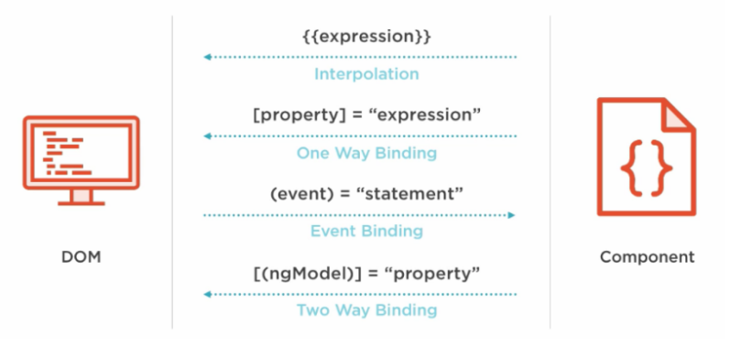

Slide 52
Interpolation
This is the easiest way of data binding in Angular JS. This is same as expression in Angular 1.x. In interpolation.
we need to supply property name is the view template, enclosed in double curly braces, eg. {{name}}.
It is used for one-way binding (Component class to View only).

Slide 53
Property binding
Property binding also known as one – way data binding.
Property binding use [] to send value from the Component to the template(View).
The ng-bind directives is used for one-way binding in Angular 1.x.
Angular 2 uses HTML DOM element property for one-way binding. The square brackets are used with property name for one-way data binding in Angular 2.
<p>Welcome to <span [innerText]="title"></span></p>
Enter Full Name :<input type="text" [value]="fullName">

Slide 54
Interpolation Vs Property binding
String interpolation - {{expression}} - render the bound value from component's template and it converts this expression into a string.
Property binding - [target]="expression" - does the same thing by rendering value from component to template.
But if you want to bind the expression that is other than string (for example - boolean), then property binding is the best option.

Slide 55
Two – way binding
The ng-model directives is used for two-way binding {{ }} in Angular 1.x,
But it is replaced with [(ngModel)] in Angular 2.0. The ngModel directive is part of the build-in Angular module called "FormsModule".
So, we must import this module in to the template module before using the ngModel directive.
<input [(ngModel)]="userName">
The User Name is {{userName}}

Slide 56
Event Binding
Angular 2.0 directly uses the valid HTML DOM elements event. For example, ng-click is now replaced by (click).
The round brackets (parentheses) are used with DOM event name for event binding in Angular 2.
(click)
(dblclick)
(mouseenter)
(mousedown)
(keyup)
(keydown)
(submit) etc

Slide 57
Two – way binding without ngModel
Angular 2 has feature called "template reference variables". With this features.
We are able to have directive access to an element. The template reference variable is declared by preceding an identifiers with a hash/pound character (#).
With reference template is completely self-contained and it doesn't bind to the component.
This solution will not work unless we bind to the element's event.
<input #userName type="text" (keyup)="0">
The User Name is {{userName.value}}

Slide 58
Angular JS directives
Directive allow you to attach behaviour to element in the DOM.
There are three types of directives
Component directive : directives with a template
Structural directive : change the DOM layout by adding and removing DOM elements.
Attribute directive : change the appearance or behaviour of an element, component or another directive.

Slide 59
Component directives
Angular component are a subset of directives. Unlike directives, components always have a template and only one component can be instantiated per an element in a template.
The specific type of directive that allows us to utilize web component functionality encapsulated, reusable elements available through our application.

Slide 60
Component directive
We can create a component like so
@Component({
selector:"my-component",
tempalte:"<p>This is user defined component</p>”
})
export class MyComponent {}

Slide 61
Structure directives
Structural directives are responsible for HTML layout.
They shape or reshape the DOM's structure, typically by adding, removing or manipulating elements.
An asterisk (*) precedes the directive attribute names.

Slide 62
Built – in structural directive
Three of the common, built-in structural directives
*ngIf
ngSwitch, *ngSwitchCase, *ngSwitchDefault
*ngFor

Slide 63
Attribute directives
Attribute directives changes the appearance or behaviour of an element.
Attribute directives are surrounded by brackets which sign to Angular that the appearance or behaviour of the DOM elements within the directive may change depending on certain conditions.
In Angular 2 are ngStyle and ngClass are the built-in attribute directives.
In Angular 1.x there was the ng-show and ng-hide directives, which show or hide elements depending on what the given expression evaluates to by setting the display CSS property.

Slide 64
Sample demo
<p [ngClass]=" 'myClass' ">Apply style binding - Using ngClass</p>
<p [ngClass]="{classOne:cone,classTwo:ctwo}">ngClass paragraph is here!</p>
<p [ngStyle]="{'color':colorValue,'font-size':fsize}">ngStyle paragraph is here!</p>
<p [ngStyle]=“ styleVariable”>ngStyle paragraph is here!</p>

Slide 65
Custom directive
import required modules like Directive, ElementRef from Angular 2 core library.
Create a TypeScript class decorate the class with @directive
Set the value of the selector property in @directive decorator function. The directive would be used, using the selector value on the elements.
In the constructor of the class, inject ElementRef.

Slide 66
Angular pipe
In Angular 2, pipe (filter) is use to format the data.
A pipe takes in data as input and transforms it to a desired output.
So In Angular we use the | pipe character to format our data.
Currency
Date
Decimal
Json
lowercase and uppercase
percent

Slide 67
Custom pipe
A custom pipe is created using a Pipe decorator on a class with a name property.
The value of the name is used as a template expression while calling custom pipe, and a class must implement PipeTransform which is inside @angular/core.
It is an interface which has transform method, which takes the values that has to be piped

Slide 68
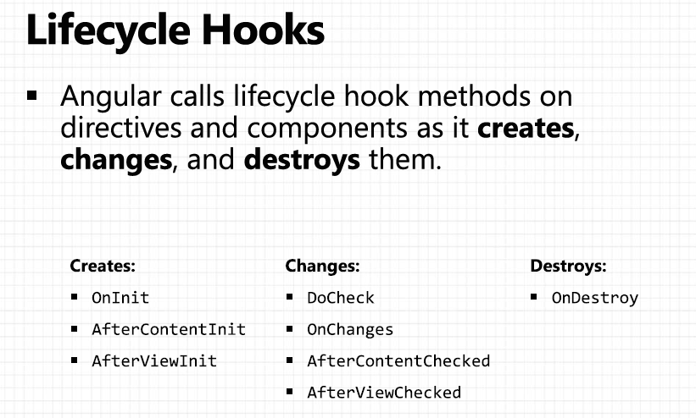

Slide 69
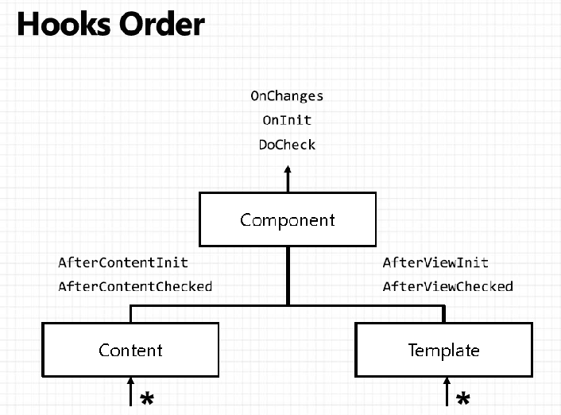

Slide 70
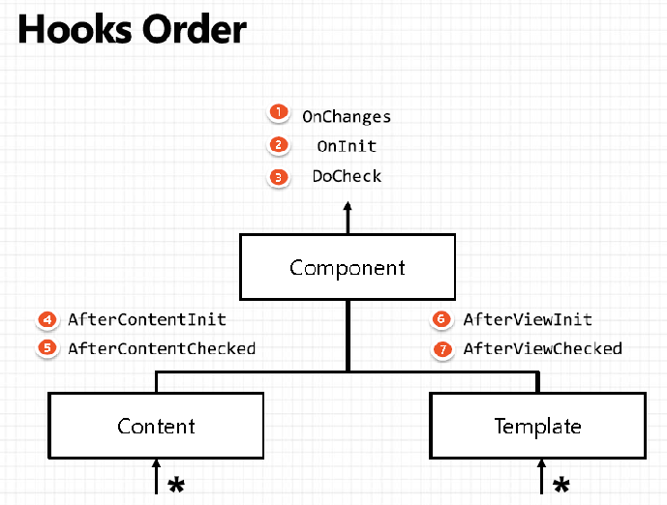

Slide 71
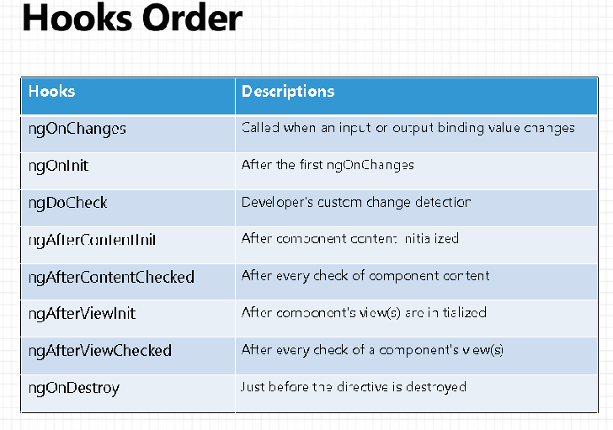

Slide 72
Inputs & Outputs
Input or @Input and Output or @Output are help to communicate two components.
Input property or @Input decorator is use to pass the value from Parent component to child component.
Output property or @Output decorator is use to pass the value from child component to parent component with the help of event emitters.

Slide 73
Angular 2 forms
Angular totally provided two types of forms
Template Driven Forms
Model Driven or Reactive approach Forms

Slide 74
TDF Vs MDF
Easy to use
Suitable for simple scenarios and fails for complex scenarios
Two way data binding(using [(NgModel)] syntax)
Minimal component code
More flexible, but needs a lot of practice
Handles any complex scenarios
No data binding is done
More component code and less HTML markup

Slide 75
Template driven form
When we want to use the template driven form first we have to use the FormsModule in module(AppModule).
The we have to use the ngForm Directives.
It provides use information about the current state of the form state of the form including.
A JSON representation of the form value.
Validity state of the entire form.

Slide 76
ngFormDirective
<form #formRef="ngForm" (submit)="checkValue(formRef.value)">
</form>

Slide 77
ngModel directive
In order to register form controls on an ngForm instance we use the ngModel directive.
In combination with a name attribute, ngModel creates a form control abstraction for use behind the scenes.
Every form controls that is registered with ngModel will automatically shows up in form.value

Slide 78
ngForm with ngModel
<form #formRef="ngForm" (submit)="checkValue(formRef.value)">
<input type=“text” name=“uname” ngModel>
</form>

Slide 79
ngModelGroup
<div ngModelGroup="FullName">
FirstName:<input type="text" name="fname"ngModel>
LastName:<input type="text" name="lname"ngModel>
</div>

Slide 80
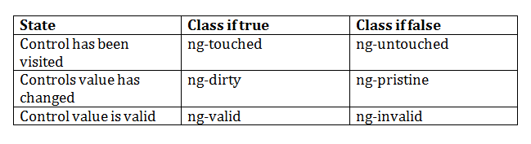
Angular pre-defined validation classes
componentRefName.errors.required
componentRefName.errors.minlength
componentRefName.errors.maxlength

Slide 81
ngForm with ngModel with Validation
<form #formObj="ngForm“ (ngSubmit)="verify(formObj.value)“ nonvalidate>
<input type="text" name="user" ngModel required #userRef="ngModel” minlength="2"/>
<div *ngIf="userRef.errors && (userRef.dirty || userRef.touched)">
<span [hidden]="!userRef.errors.required">
UserName is required
</span>
<span [hidden]="!userRef.errors.minlength">
UserName must be 2 character
</span>
</div>
<input type="submit" [disabled]="!formObj.valid">

Slide 82
Model Driven Forms
Model Driven Forms also known as Reactive forms.
In this approach, we create new instances of the form controls and form control group in our component.
When we want to use the model driven form first we have to use the ReactiveFormsModule in module(AppModule).

Slide 83
FormGroup and FormGroupControl
FormControl : The class is present in the "@angular/forms" package of Angular 2.0.Each component in form like textfield, radiobutton, checkbox is known as FormControl
FormGroup : The class is present in the "@angular/forms" package of Angular 2.0. It is used to represent a set of form control inside its constructor.

Slide 84
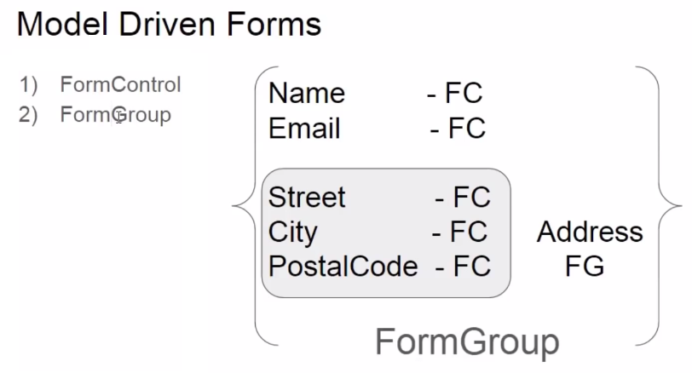

Slide 85
In Component
userForm=new FormGroup({
uname:new FormControl(),
pname:new FormControl(),
addressForm=new FormGroup({
.....
.....
})
});

Slide 86
In Template
<form [fromGroup]=“userForm”>
<input type=“text” formControlName=“uname”>
........
........
........
</form>

Slide 87
Model Driven form with Validation
Import the Validators from the ‘@angular/forms”.
Which provide set of field which help to do the validation.
userForm=new FormGroup({
uname:new FormControl(‘’,[Validators.required,Validators.minLength(3)]),
pname:new FormControl(‘’,[Validators.required,Validators.maxLength(6)]),
});

Slide 88
<form [formGroup]="loginForm" (submit)="verify()" nonvalidate>
<input type="text" formControlName="user" required/>
div *ngIf="!loginForm.controls.user?.valid && (loginForm.controls.user?.dirty
|| loginForm.controls.user?.touched)">
<div [hidden]="!loginForm.controls.user.errors.required">
UserName is required
</div>
<div [hidden]="!loginForm.controls.user.errors.minlength">
Min Length must be 2 character
</div>
</div>
<input type="submit" value="submit" [disabled]="!loginForm.valid">

Slide 89
Angular Service
Services allow for greater separation of concerns for your application and better modularity by allowing you to extract common functionality out of component.
Service is used when a common functionality need to be provided for various modules.
Angular also comes with its own dependency injection framework for resolving dependencies, so you can have your services depend on other services through out your application, and dependency injection will resolve your dependencies for you.

Slide 90
Dependency Injection
DI is a coding pattern in which a class receives its dependencies from external sources rather than creating them itself.

Slide 91
Types of Service in Angular 2
User-defined service
Pre-defined service

Slide 92
Steps to create the Service
Import the injectable member
Add the @injectable Decorator
Export Service class

Slide 93
Register the Service
We can register the service in two ways
In Component
In Module

Slide 94
In Component
There are four simple steps to use/import Service in the Component
import the Service to the component
Add it as a provider
Include it through Dependency injection
Use the Service function

Slide 95
In Module
There are four simple steps to use/import Service in the Module
import the Service to the module
Add it as a provider
Include it through Dependency injection in Component
Use the Service function

Slide 96
Angular 2 http service
One of the most common scenario in any application is client interacting with the server.
Http is the widely used protocol for this interaction.
One can fetch data from the server, update data, create data and delete data using HTTP protocol.
In Angular 2 http service return the Observable but Angular 1.x is http service return the Promise object.

Slide 97
JavaScript callback function
A callback function is a function passed into another function as an argument, which is then invoked inside the outer function to complete some kind of routine or action.
Callback function may be synchronous and asynchronous functions.

Slide 98
Synchronous and Asynchronous
In synchronous programs, if you have two lines of code (L1 followed by L2), then L2 cannot begin running until L1 has finished executing.
In asynchronous programs, you can have two lines of code (L1 followed by L2), where L1 schedules some task to be run in the future, but L2 runs before that task completes.

Slide 99
What is promise
Promise is a one type of callback function, which represents the eventual result of an operation. You can use a promise to specify what to do when an operation eventually succeeds or fails.

Slide 100
The Promise
The Promise is an object, with two functions.
then() => Promise, please get the value from that URL.
error() => Promise, please call this function when you have a new error for me.

Slide 101
Observer pattern
The observer pattern is a software design pattern in which an object, called the subject, maintains a list of its dependents, called observers, and notifies them automatically of any state changes, usually by calling one of their methods. It is mainly used to implement distributed event handling systems.

Slide 102
Observables in Angular
You can think of an observable as an array whose items arrive asynchronously over time.
Observables help you manage asynchronous data, such as data coming from a backend service. Observables are used within Angular itself, including AngularJS event system and its http client service. To use observables, Angular uses a third-party library called Reactive Extensions (RxJS). Observables are a proposed feature for ES 2016, the next version of JavaScript.

Slide 103
The Observer
The Observer is an object, with three functions.
next() => Observable, please call this function when you have a new value for me.
error() => Observable, please call this function when you have a new error for me.
complete() => Observable, please call this function when you complete your job.

Slide 104
Observable Vs Promise
Observables
Observables handle multiple values over time.
Observable are cancellable.
Promise
Promise are only called once and will return a single value.
Promises are not cancellable.

Slide 105
What is RxJS
RxJS or Reactive Extensions for JavaScript is a library for transforming, composing, and querying streams of data.
We mean all kinds of data too, from simple arrays of values, to series of events
RxJS can be used both in the browser or in the server-side using Node.js.
Asynchronous, in JavaScript means we can call a function and register a callback to be notified when results are available.
Data, raw information in the form of JavaScript data types as: Number, String, Objects (Arrays, Sets, Maps).
Streams, sequences of data made available over time.

Slide 106
Demo Example
var Rx=require("rx");
var source = Rx.Observable.range(1,5);
var sub = source.subscribe(
x=>console.log(x),
e=>console.log(e),
()=>console.log("completed")
)

Slide 107
http service
http:- It is for callback, used for performing XMLHttpRequest operations like get(), post(), delete(), put(),
All the Http methods return Observable, from Observable we use an operator map() to manipulate the data, the data would be in a Response which you get once you call subscribe() method
map(res => response.text())
map(res => response.json())
The map would get the response once the subscribe() is called however the response must be assigned to a class property such that it can be displayed finally

Slide 108
Routing
Routing helps to direct to different pages based on the options user select, using Routing you can render components to the users based on the options they select.
So the browser doesn’t load the whole page instead it only loads the component which we selected at runtime;

Slide 109
Steps to create the routing
Create the .ts routing file (app.routing.ts)
Import the NgModule from @angular/core, Routes and RouterModule from @angular/router' and all component which want to route at runtime.
Now we have to create the variable of type Routes. Which contains path and component property based upon the number of component want to route.

Slide 110
Syntax
const routes:Routes=[
{path:’’,redirectTo=“\first”,pathMatch=“full”},
{path:'first',component:FirstComponent},
{path:'second',component:SecondComponent},
{path:'third',component:ThirdComponent,
children:[
{path:‘thirdone',component:ThirdOneComponent},
{path:‘thirdtwo,component:ThirdTwoComponent,
]}
]

Slide 111
Continue...
Then create the class with @ngModule and use the two properties as import and export.
With following syntax
imports:[RouterModule.forRoot(routes)],
exports:[RouterModule]

Slide 112
In template
<div>
<a routerLink=“[‘/first’]">First Component</a>
<a routerLink=“[‘/second’]">Second Component</a>
<a routerLink=“[‘/third’]">Third Component</a>
</div>
<div>
<router-outlet></router-outlet>
</div>

Slide 113
Deploy the project in external server
Once we created the application from Angular-CLI, we get all the configurations in the project itself for developing an app whose size will be almost 160MB or more.
but when we deploy these applications on the server we need the build files which can process the requests from the client whose size will be less than 1MB, to build the applications and deploy in Tomcat server or any web server.
ng build --prod --build-optimizer

